Slide 1
CH3150 MASS TRANSFER-|| Group-3

Slide 2
Counter / Cross current
Data Generation
Fitting data to a neural network model
Input: Enter alpha value
Input: Enter solvent Rate
Counter current
Cross current
Output: Number of stages
Output: Number of stages

Slide 3
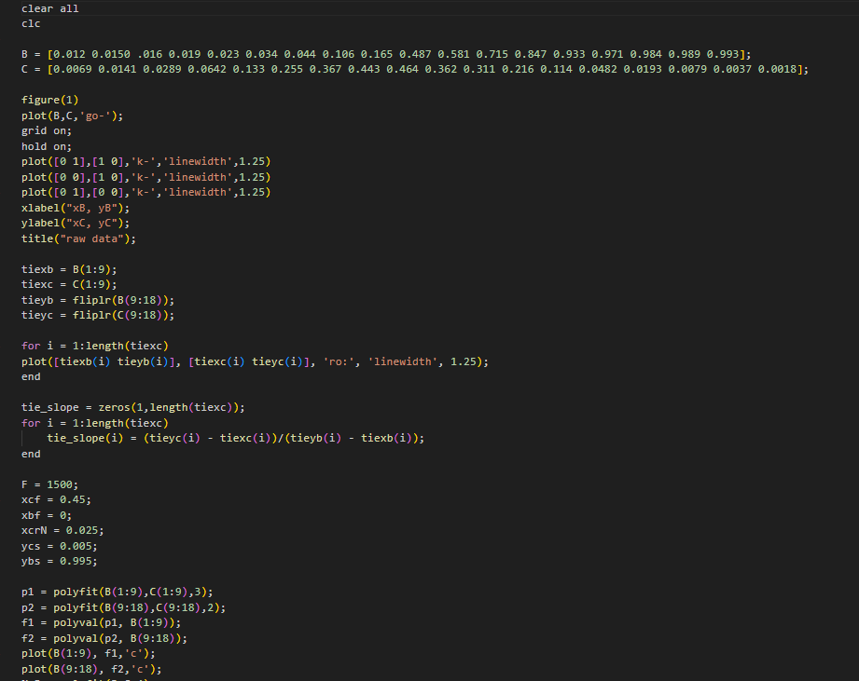
 | Counter Current: In the following code snippets, we have declared the raffinate and extract data. We get the coordinates for tie lines points and then calculate their respective slopes. We initialize the other parameters required for the Countercurrent LLE scheme like xcf, ycs, xbf, xcrN, ybs etc. We fit the raffinate and extract data using polyfit and assume it to be a 3 and 2 degree polynomial. The fitted curves are plotted on the same graph. The curve corresponding to B(1:9) is plotted in cyan, while the curve for B(9:18) is also plotted in cyan.

Slide 4
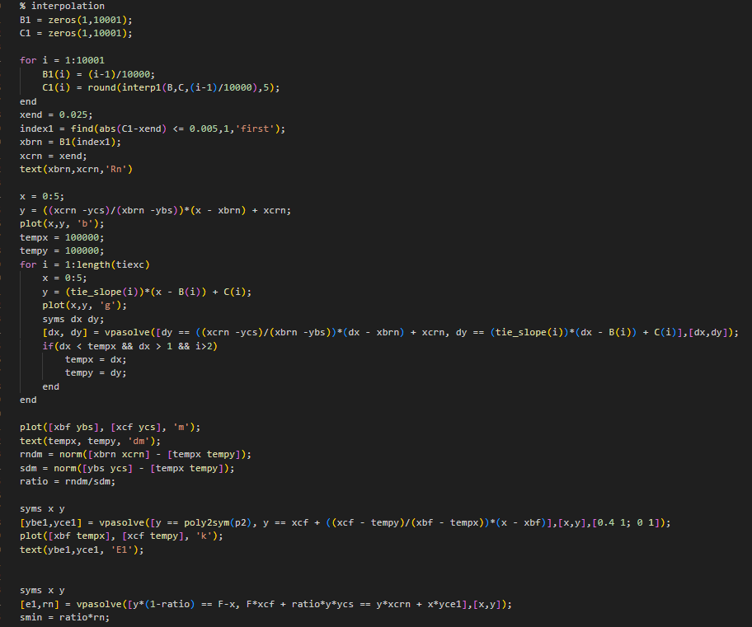
Finding minimum solvent Rate Interpolation: It interpolates the values in array C at the points determined by array B, using interp1. It rounds the interpolated values to 5 decimal places and stores them in arrays B1 and C1. Finding Delta_Min: It solves systems of equations symbolically using vpasolve. Specifically, it solves for variables dx and dy in the loop, and later for x and y using the vpasolve function. Calculation: Based on the values it got, it calculates the rndm, sdm ,ratio and smin. smin=rndm/sdm

Slide 5
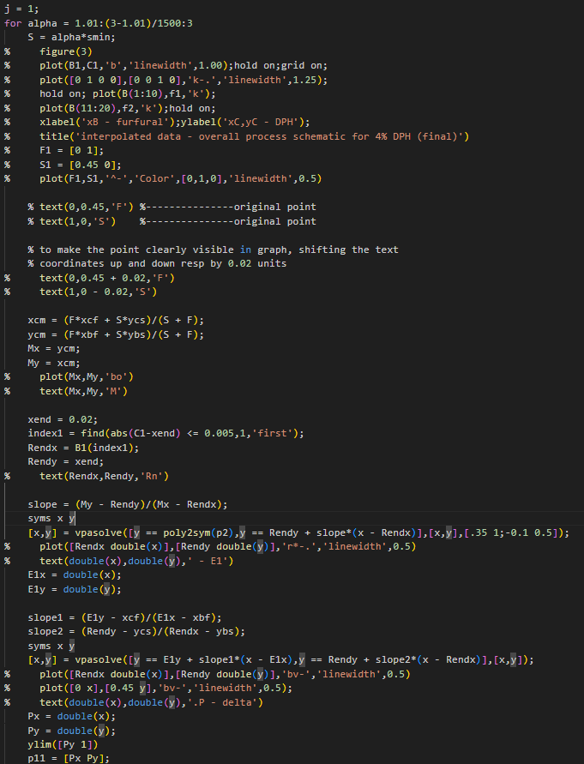
Iteration over alpha values: The loop iterates over alpha values ranging from 1.01 to 3 with a step size of (3-1.01)/1500. It calculates the coordinates of point M based on alpha, smin, and predefined constants. It locates the coordinates of point Rn Using the slope between point M and Rn, it finds the coordinates of point E1 by solving a system of equations. It calculates slopes slope1 and slope2 for further calculations. Using these slopes, it finds the coordinates of point P by solving another system of equations. The coordinates of points E1 and P are calculated within the loop, and their values are stored in variables E1x, E1y, Px, and Py. The line p11 = [Px Py]; simply creates a point with coordinates [Px, Py]. A description of this point could be something like "Point P represents the intersection of two lines in the graph, calculated for the given value of alpha."

Slide 6
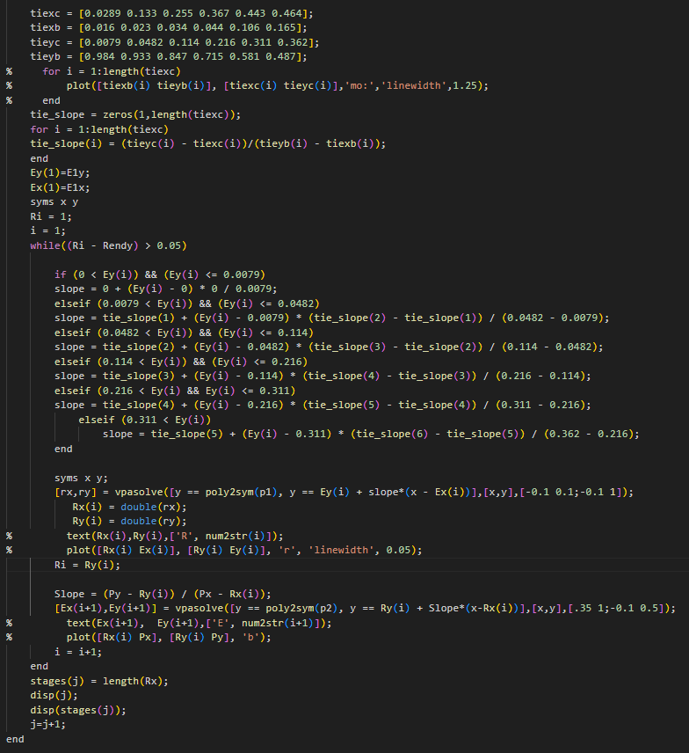
Data Generation: It computes the slope between corresponding points in tiexc, tiexb, tieyc, and tieyb. It initializes symbolic variables x and y, and sets initial values for Ri, i, and j. The main computation occurs within a while loop that continues until a certain condition ((Ri - Rendy) > 0.05) is met. Within the loop, it calculates slopes based on the values of Ey(i). It then solves equations symbolically (vpasolve) to find intersections between lines and polynomials, storing the results in Rx and Ry. It also calculates a slope (Slope) and solves another set of equations to find new Ex and Ey values. The loop iterates, updating i, Ri, Ex, and Ey until the convergence condition is met. It stores the length of Rx in stages(j) and increments j at each iteration. It outputs the value of j and the corresponding length of Rx at each iteration.

Slide 7
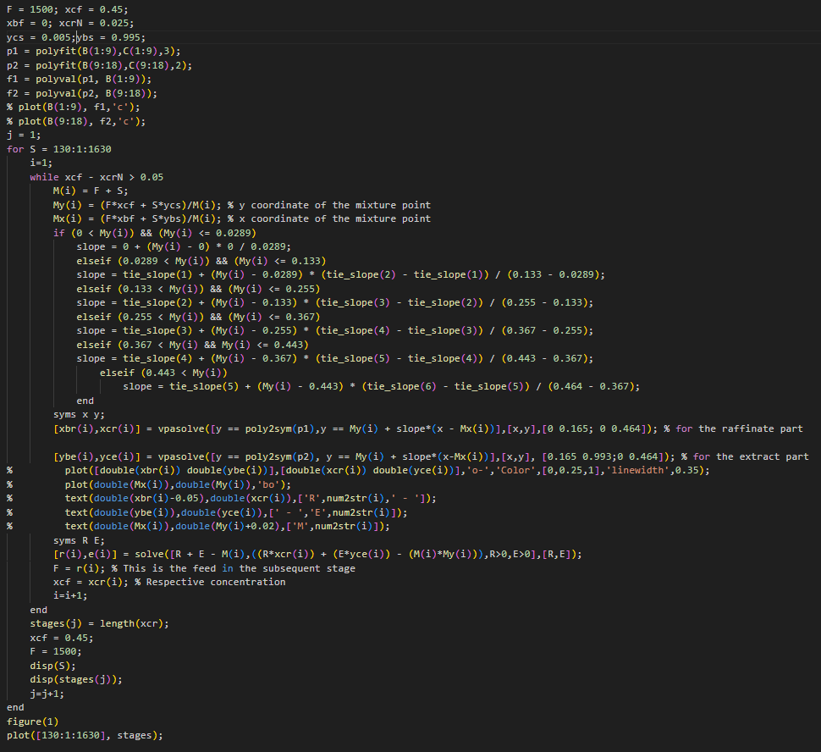
Cross Current: Data Generation j is initialized to 1. A loop iterates over values of S from 130 to 1630. Within the loop, there's another loop that continues until a condition (xcf - xcrN > 0.05) is met. Within this inner loop, certain calculations are performed based on the values of F and S, Values for M, My, and Mx are calculated. Slopes are determined based on My values and tie slopes. Equations are solved symbolically (vpasolve) to find xbr, xcr, ybe, and yce. Further calculations are performed to find values for r and e. F and xcf are updated for the subsequent stage. The loop continues until the condition is met. The length of xcr for each S value is stored in stages(j). j is incremented. After the loop completes, it plots the values of stages against the range of S values using plot.

Slide 8
Fitting data to a Neural Network Model
Counter current: #load the data df = pd.read_excel(‘counter_current_data.xlsx’) #Split the data into input and output X = df.iloc[:,0] #Input y = df.iloc[:,1] #Output #Convert series to dataframe X = X.to_frame() y = y.to_frame() #Split the data into training and testing from sklearn.model_selection import train_test_split X_train,X_test,y_train,y_test = train_test_split(X,y,test_size=0.2,random_state=42) #Scale the data from sklearn.preprocessing import StandardScaler sc = StandardScaler() X_train_scaled = sc.fit_transform(X_train) X_test_scaled = sc.transform(X_test) | Cross current: #load the data df = pd.read_excel('cross_current_data.xlsx’) #Split the data into input and output X = df.iloc[:,0] #Input y = df.iloc[:,1] #Output #Convert series to dataframe X = X.to_frame() y = y.to_frame() #Split the data into training and testing from sklearn.model_selection import train_test_split X_train,X_test,y_train,y_test = train_test_split(X,y,test_size=0.2,random_state=42) #Scale the data from sklearn.preprocessing import StandardScaler sc = StandardScaler() X_train_scaled = sc.fit_transform(X_train) X_test_scaled = sc.transform(X_test)

Slide 9
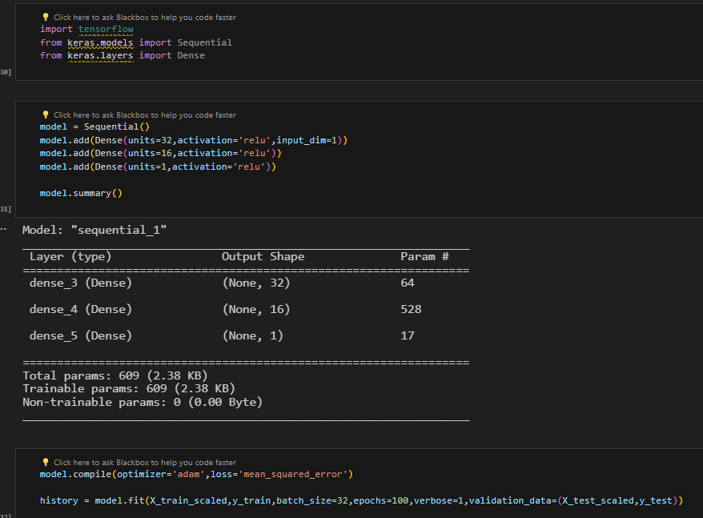
Counter current: | Cross current:

Slide 10
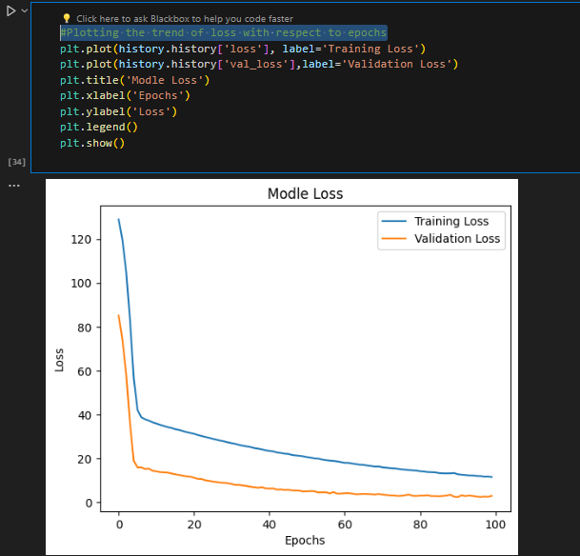
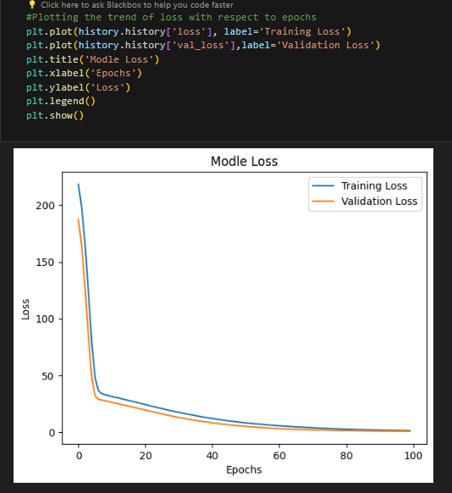
Counter current: #Model Evaluation score = model.evaluate(X_test_scaled,y_test,verbose=0) print('Test Loss:',score) #Predictions predictions = model.predict(X_test_scaled) #Plotting the trend of loss with respect to epochs | Cross current: #Model Evaluation score = model.evaluate(X_test_scaled,y_test,verbose=0) print('Test Loss:',score) #Predictions predictions = model.predict(X_test_scaled) #Plotting the trend of loss with respect to epochs

Slide 11
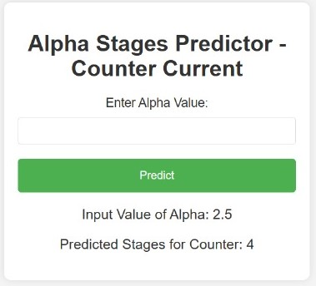
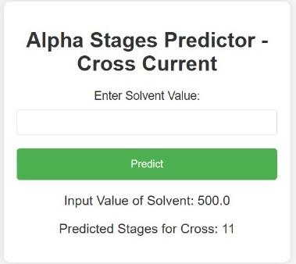
Counter current: | Cross current:

Slide 12
Thank you Johny Gahlot Bansal Banothu

